Slide 1
A large-scale benchmarking of cell type deconvolution methods
Chichau Miao, Anna Vathrakokili Pournara, Irene Papatheodorou

Slide 2
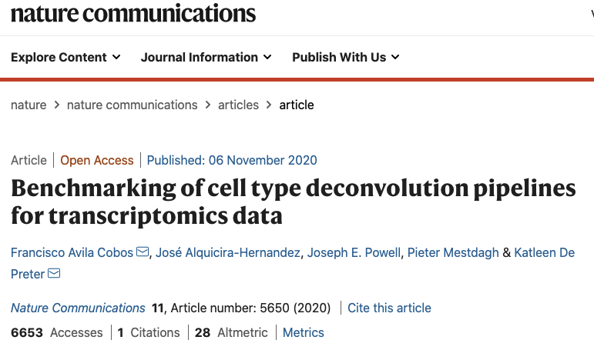
Background
Gap:
Only technical benchmarking
No real scenario analysis
Not significant in interpreting biology problems

Slide 3
Objectives
Understand the performance of deconvolution methods in dealing with bulk RNA-seq data using single-cell RNA-seq as reference;
How to deconvolve disease bulk with healthy single cell data?
How to capture the transcriptomic signal change in the disease samples?
Give suggestions for deconvolution methods to be applied in the pipeline.

Slide 4
Experimental design
 | Bulk | Reference
1: decide the parameters | pseudobulk made from reference | scRNA-seq
2: realistic benchmarking | pseudobulk made from another reference (batch effect) | scRNA-seq
3: benchmarking & potential application | Bulk RNA-seq of the same tissue | scRNA-seq
4: benchmarking & potential application | Bulk RNA-seq of the same tissue | 2 scRNA-seq

Slide 5
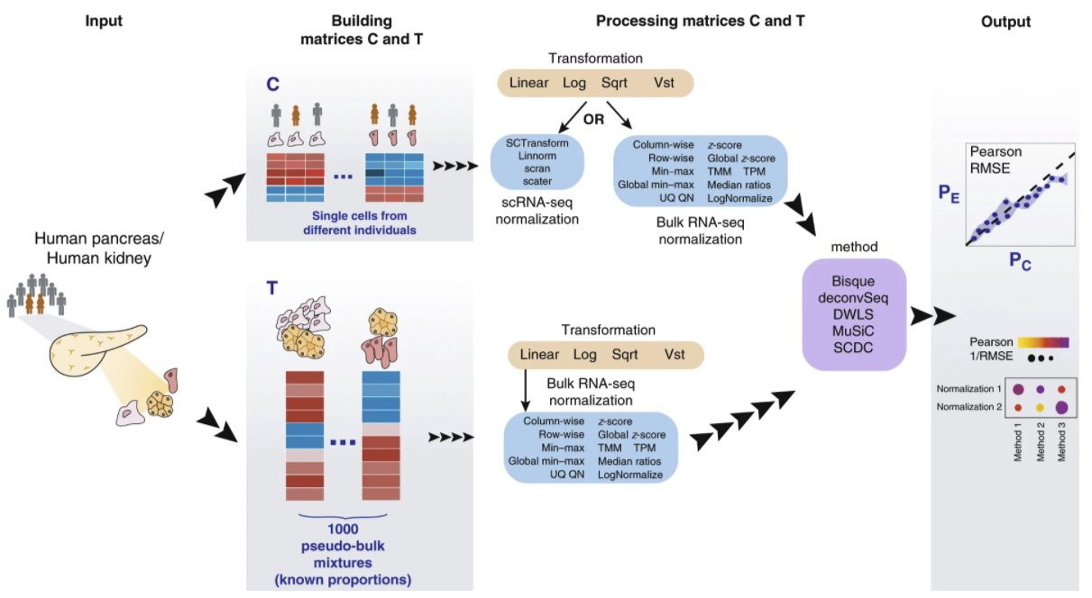
1. Self-reference (easy case)
Anndata
downsample
ExpressionSet

Slide 6
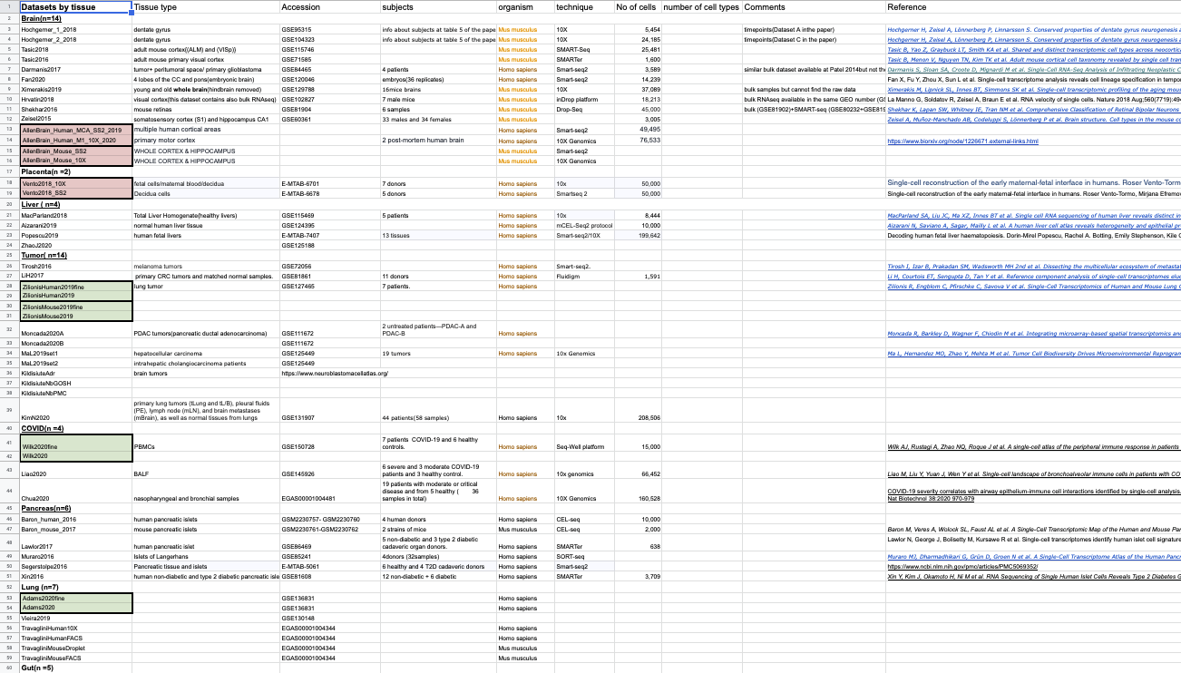
Datasets

Slide 7
Datasets
>57 datasets, covering brain (14), placenta(2), liver(4), tumor(14), COVID-19(4), Pancreas(6), Lung(7),Gut(5), Muscle(1)
10X and Smart-seq2 (SS2) in the same study
10X and SS2 for the same tissue from different studies
10X and bulk in the same study
10X and bulk for the same tissue from different studies
Coarse and fine cell type annotations (4 datasets)

Slide 8
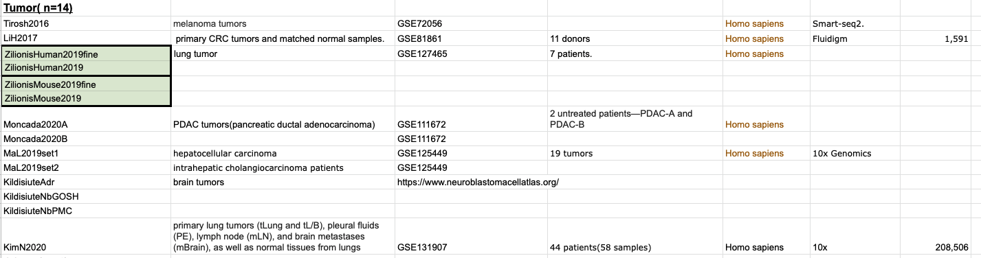
Tumor datasets

Slide 9
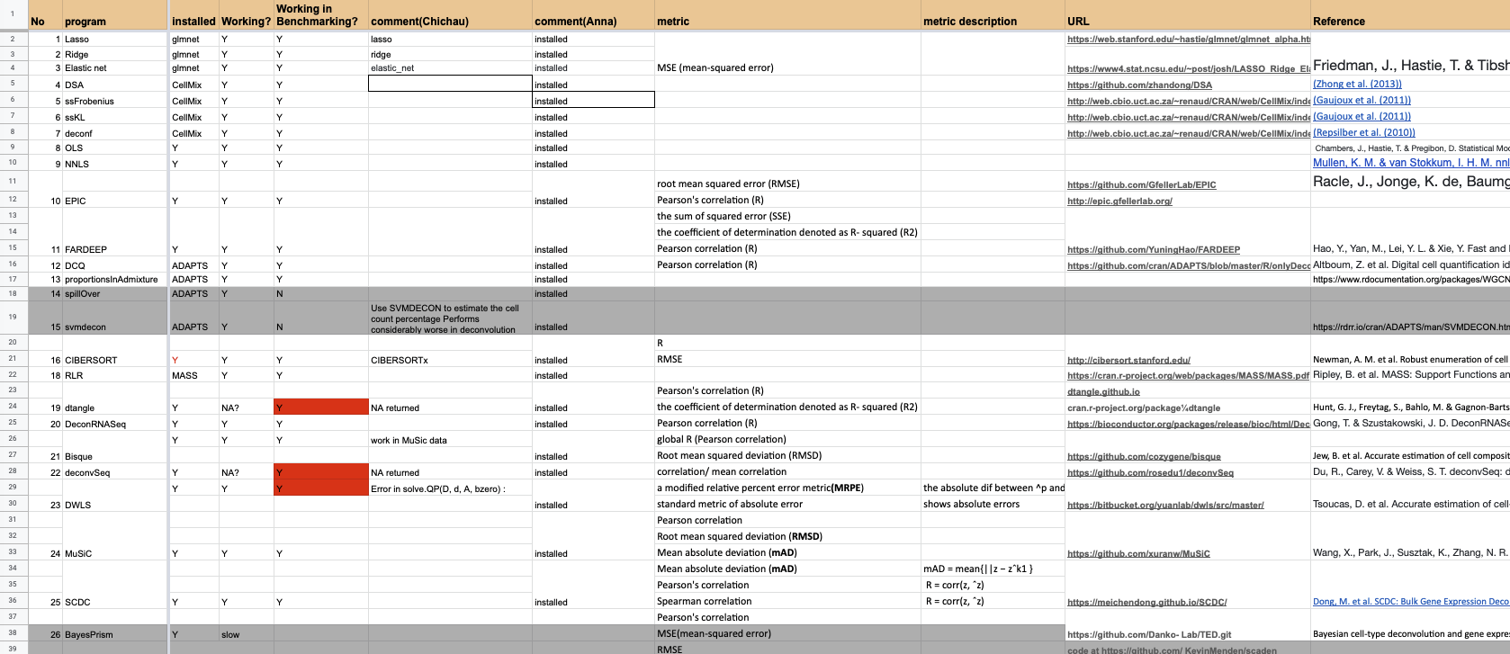
Deconvolution methods

Slide 10
Installation
Conda based dependencies
Independent programs
Bioconda based R packages
Cran based R packages
Github based packages

Slide 11
Preliminary tests
Bseqsc can take >9 days to compute

Slide 12
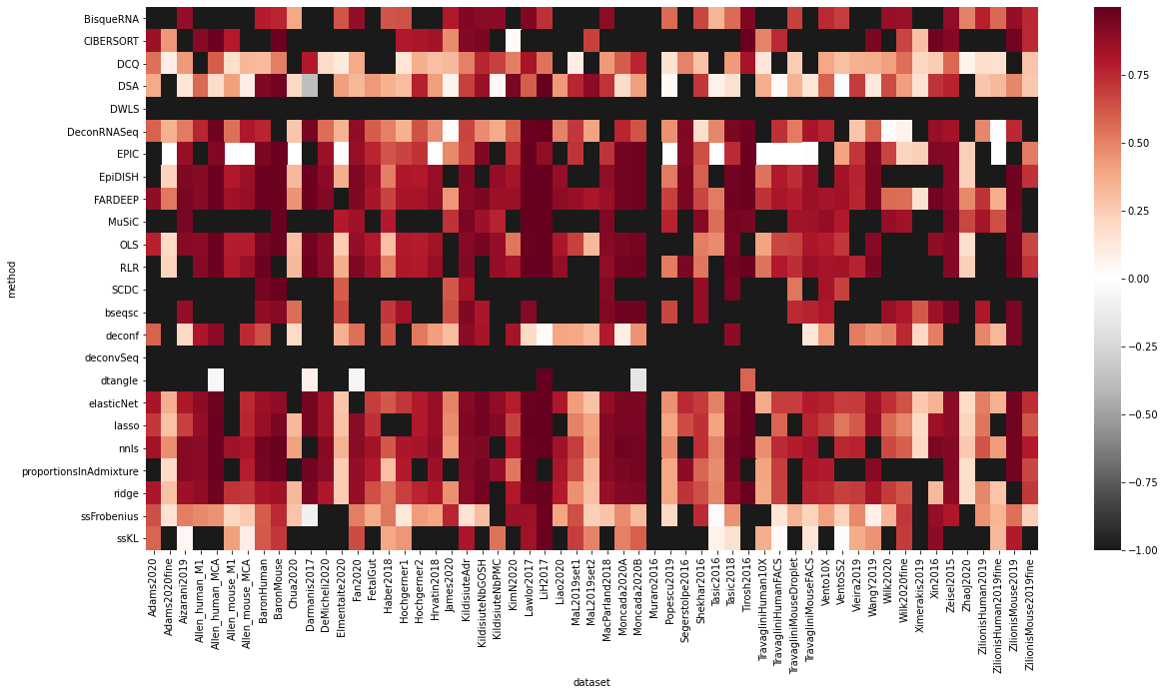
Preliminary results (Pearson correlation)

Slide 13
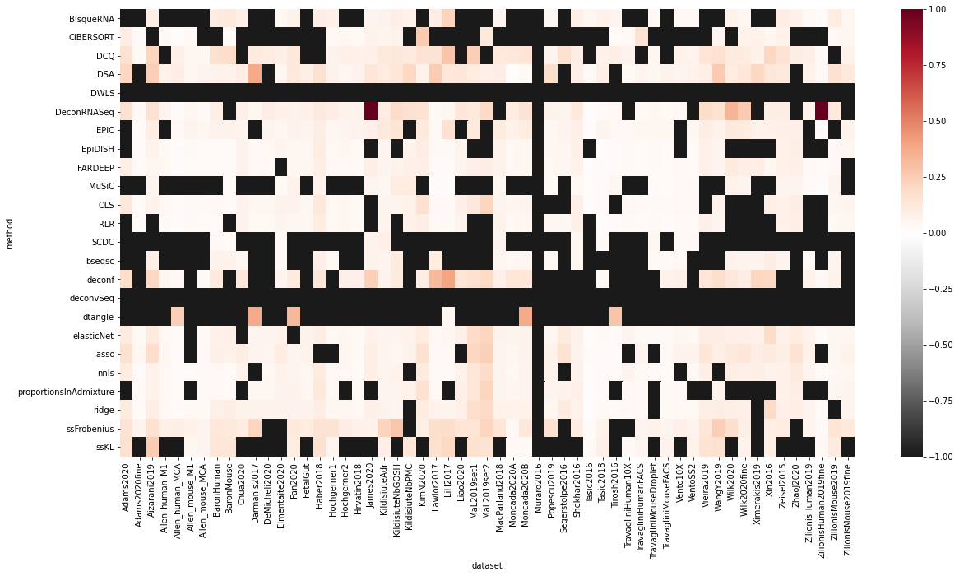
Preliminary results (RMSE)

Slide 14
Next Steps:
Deconvolution between datasets (use different datasets of the same tissue type)
Deconvolution between different techniques (10X vs SS2)
Deconvolution of bulk samples using scRNA-seq in the same study
Test the speed

Slide 15
Data Simulation

Slide 16
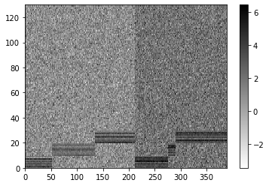
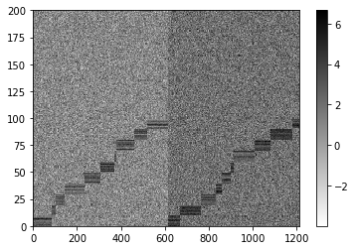
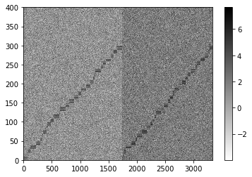
3, 10, 30 cell types

Slide 17
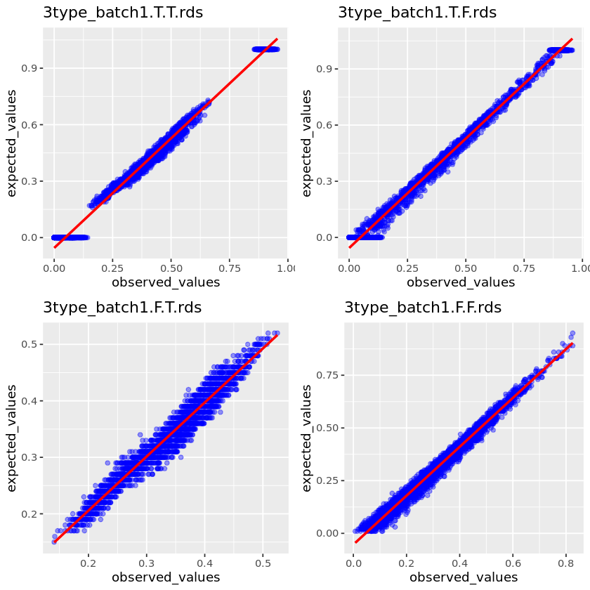
3 cell type, 100 pseudobulk | Prop Sampling | Random sampling
Sample CT
All CT

Slide 18
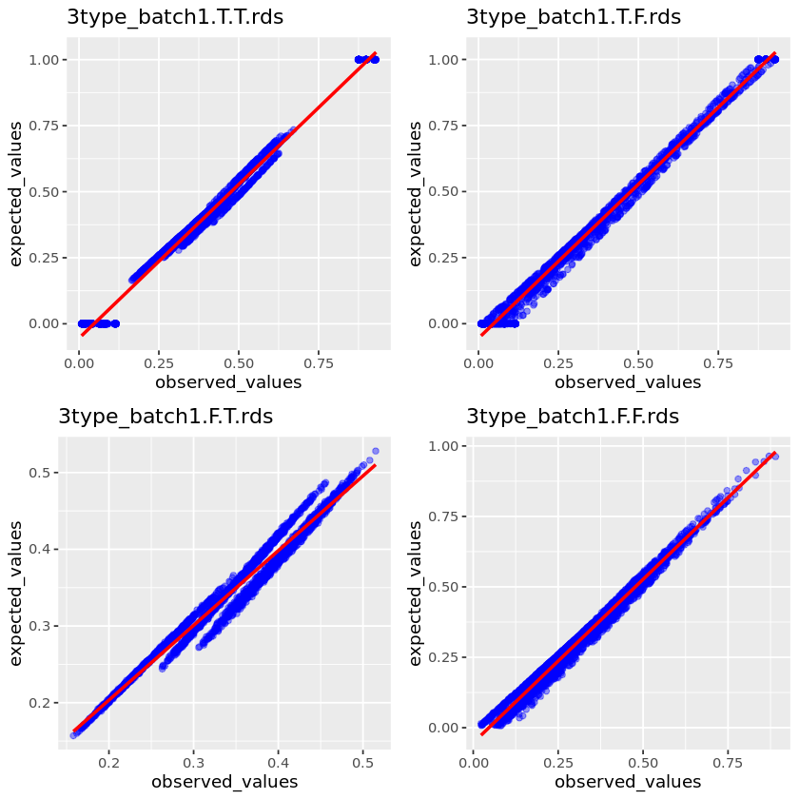
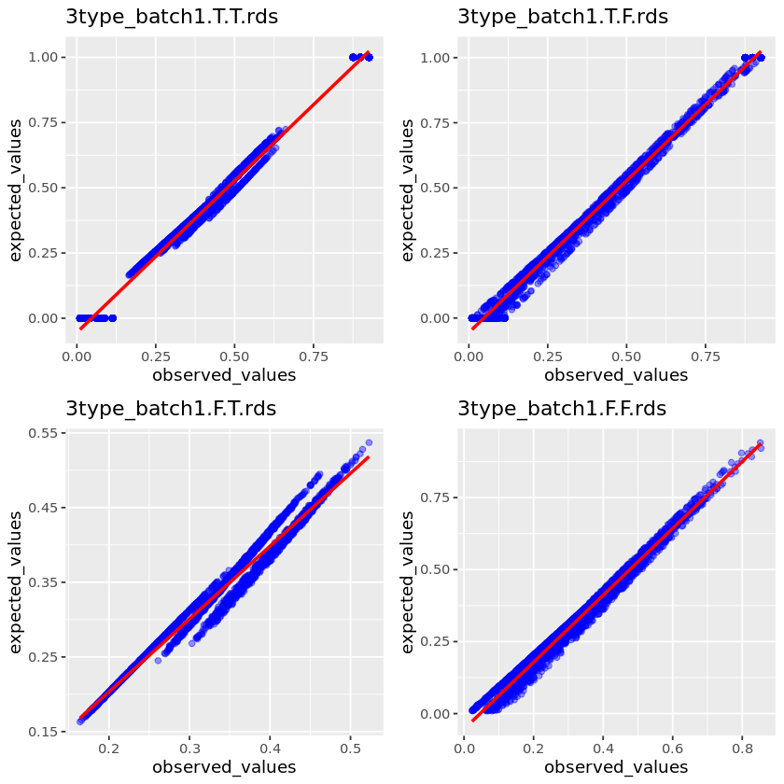
10K pseudobulk
1M pseudobulk

Slide 19
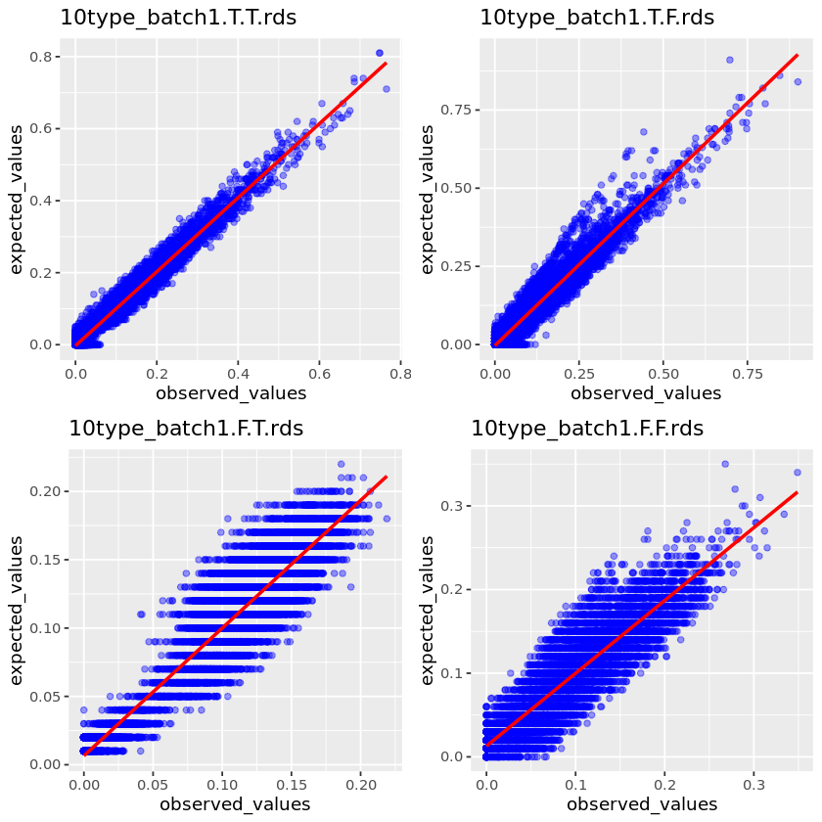
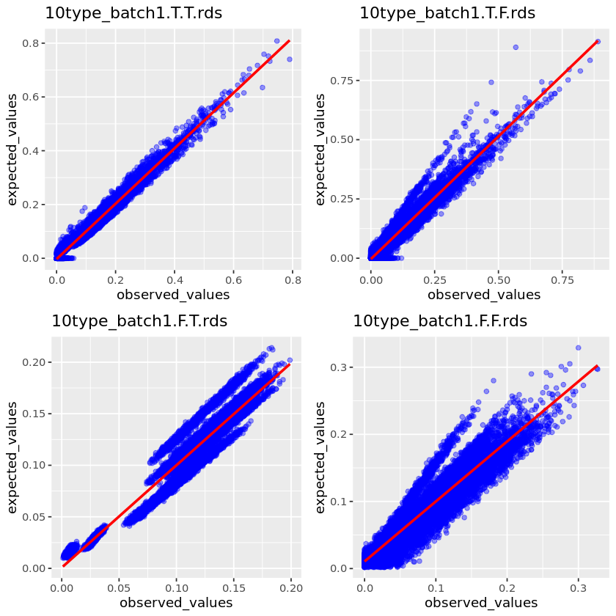
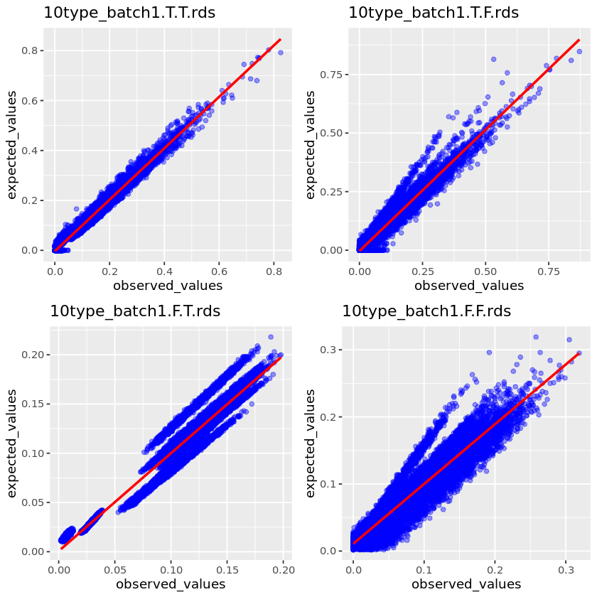
10 cell types
100 pseudobulk
10K pseudobulk
1M pseudobulk

Slide 20
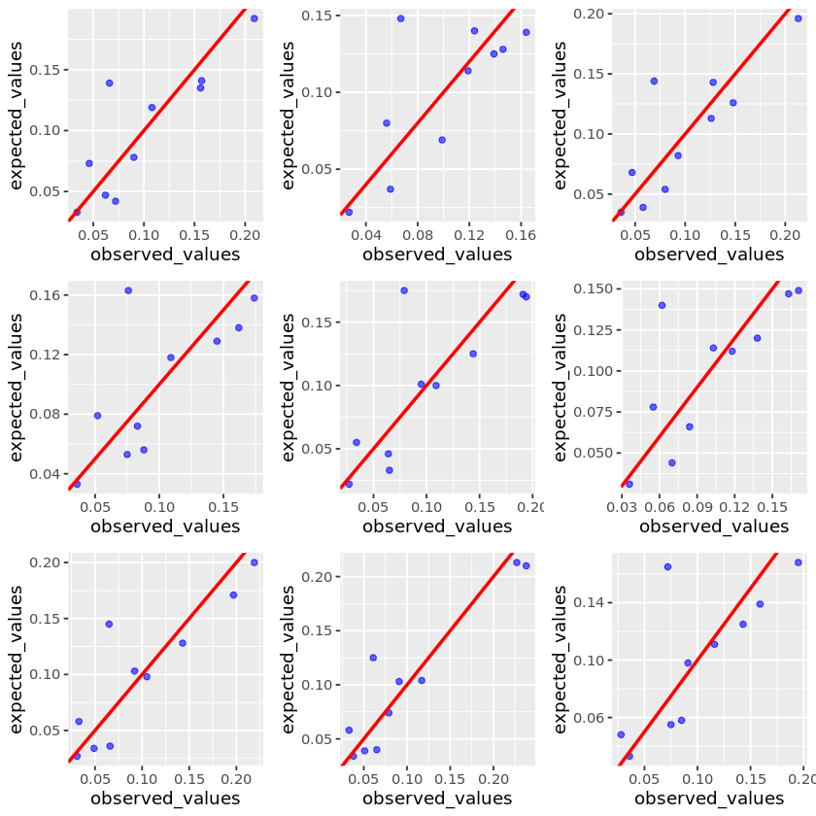
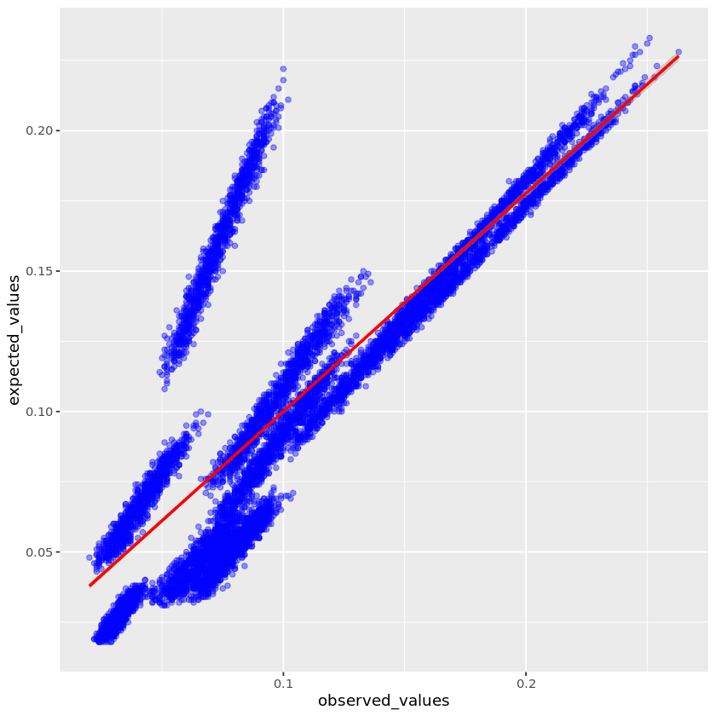
10 cell types, cross reference
10K pseudobulk
Notes:
Try another deconvolution method

Slide 21
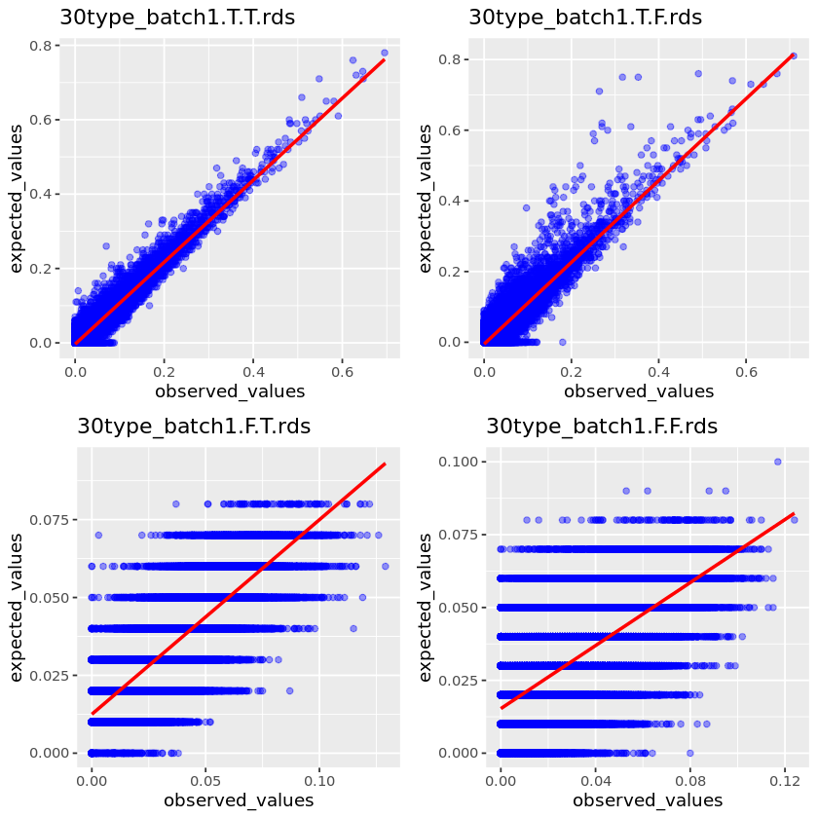
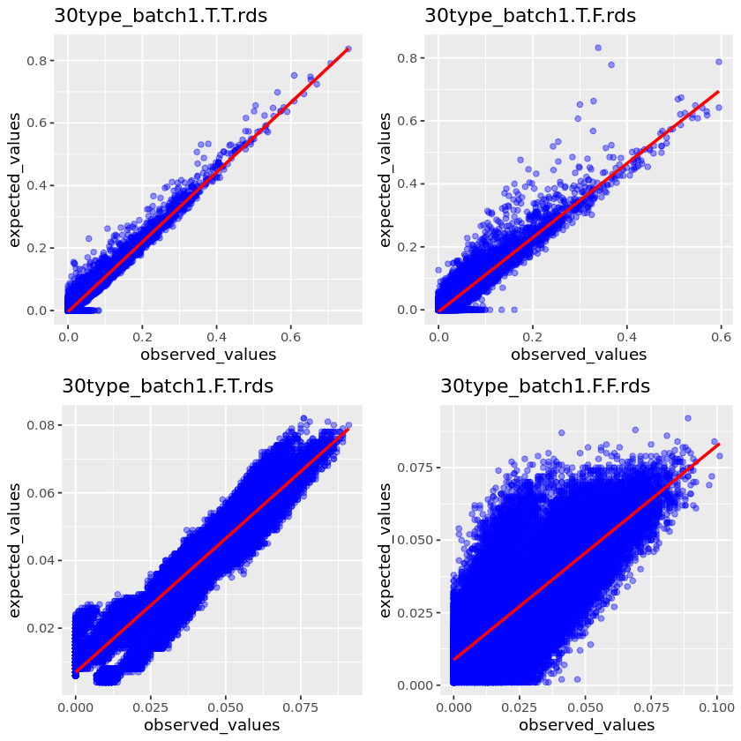
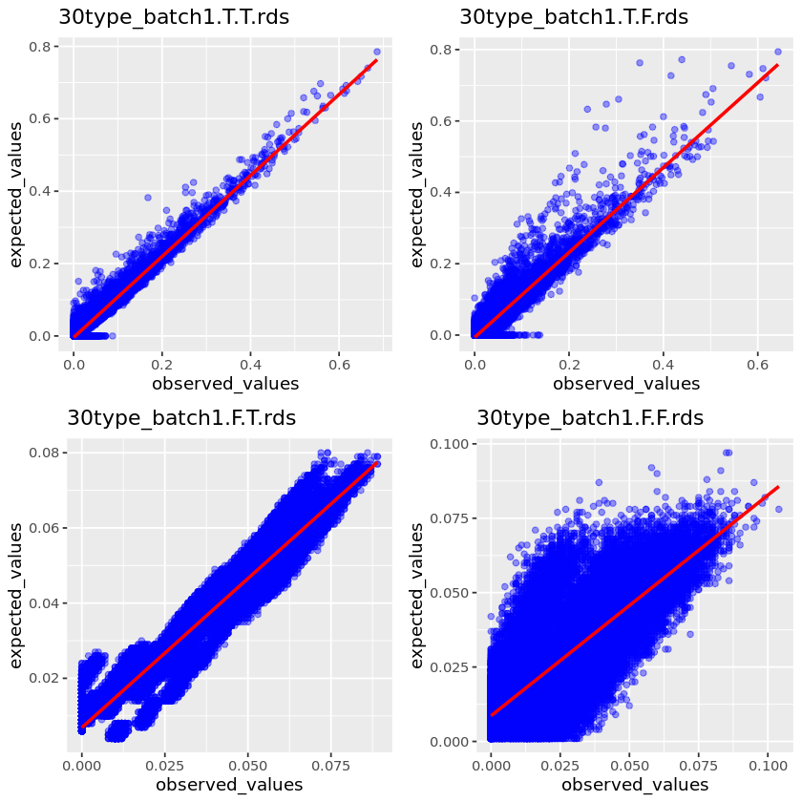
30 cell types
100 pseudobulk
10K pseudobulk
1M pseudobulk

Slide 22
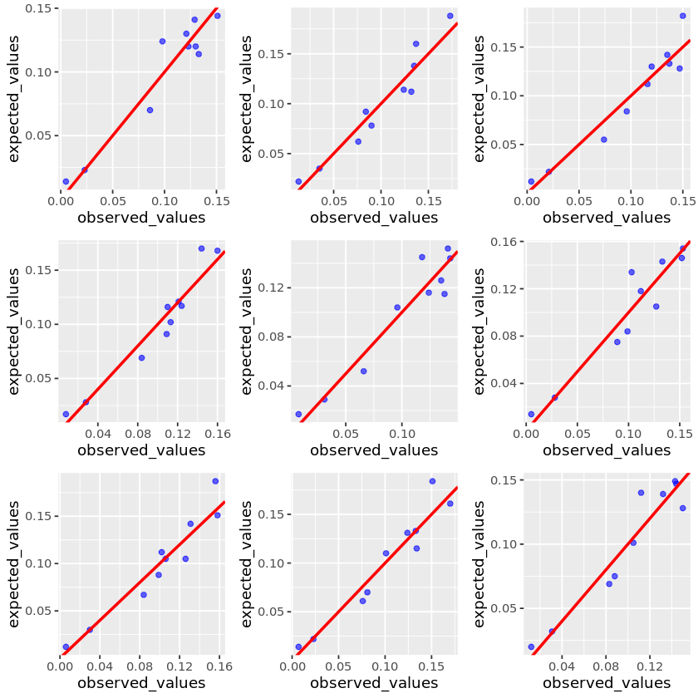
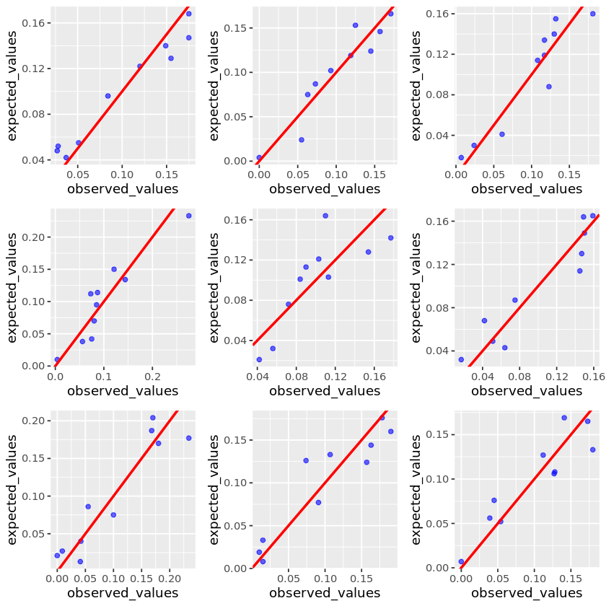
Prop sampling
10 cell types
random sampling

Slide 23
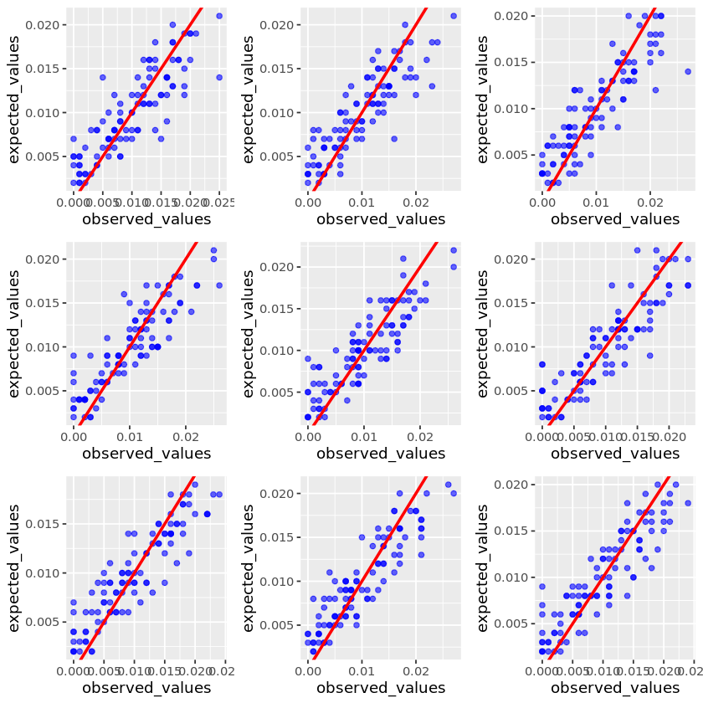
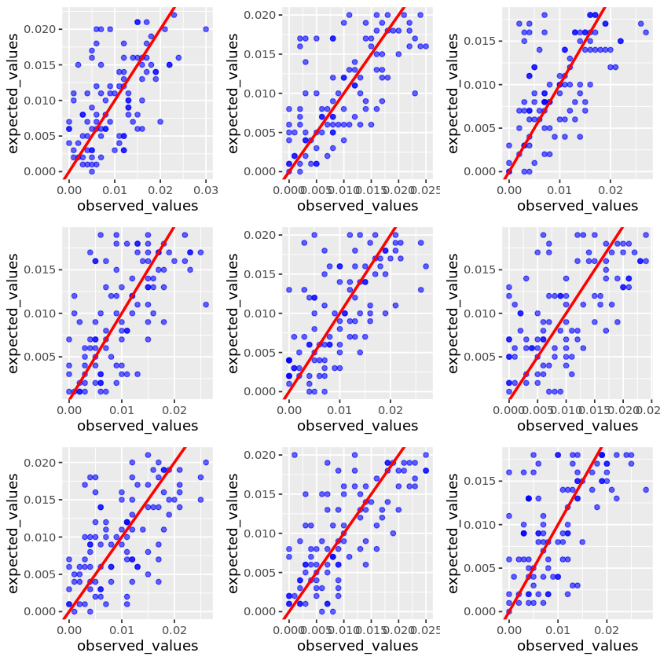
Prop sampling
100 cell types
random sampling

Slide 24
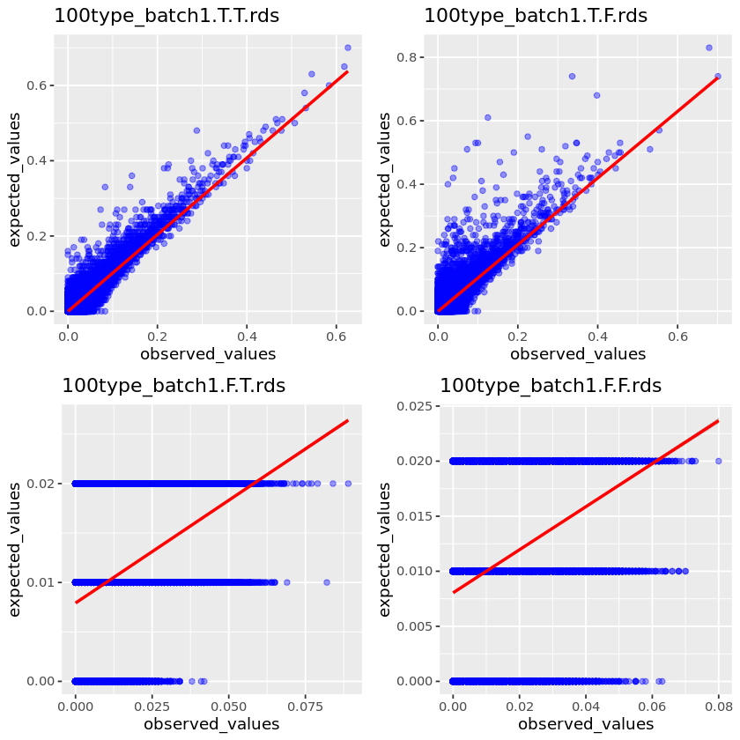
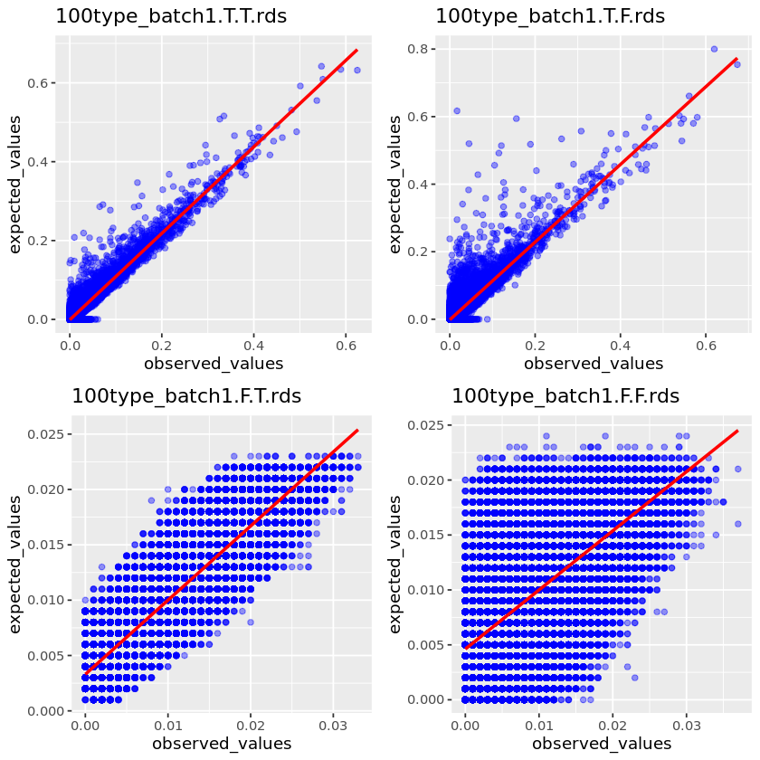
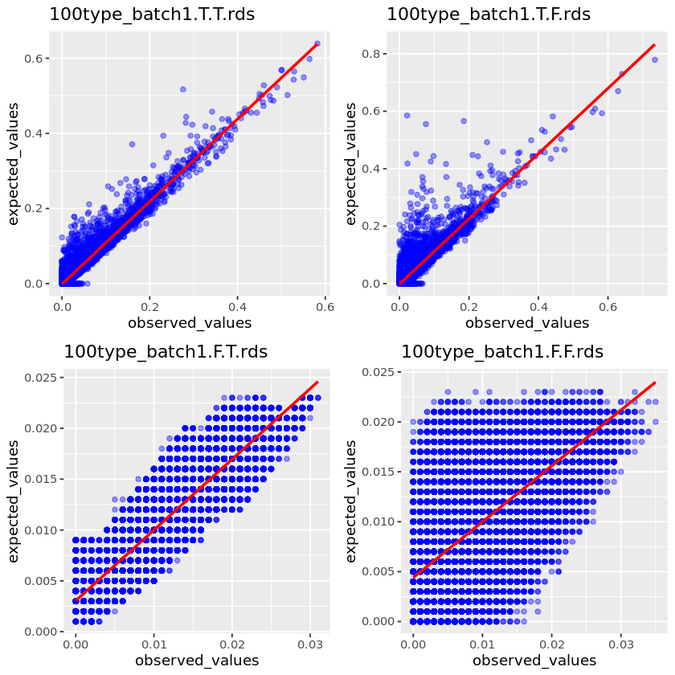
100 cell types
100 pseudobulk
10K pseudobulk
1M pseudobulk

Slide 25
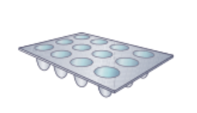
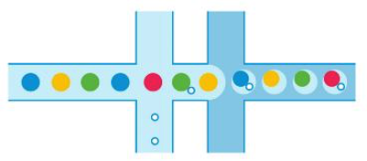




Experimental design

Slide 26
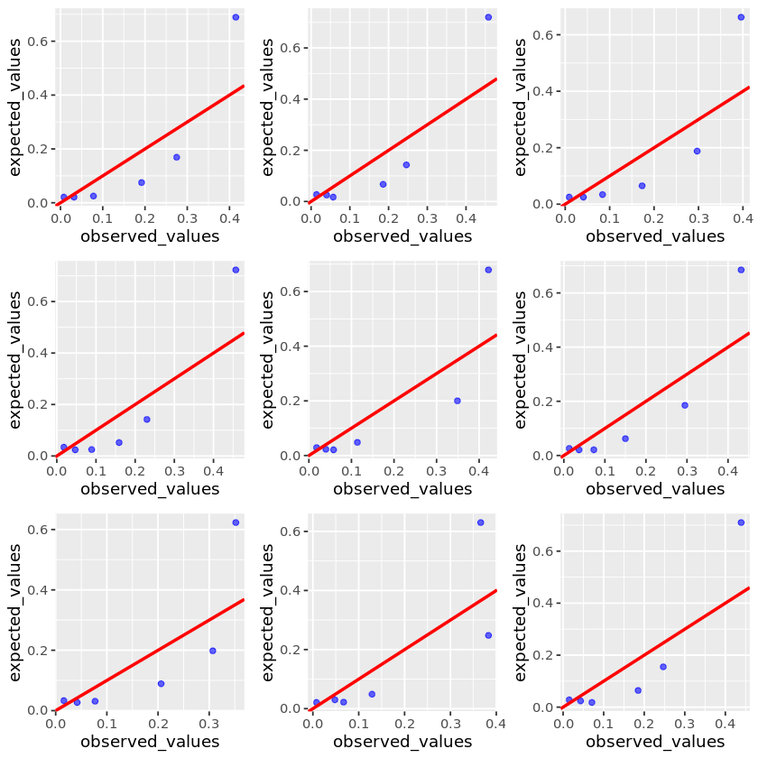
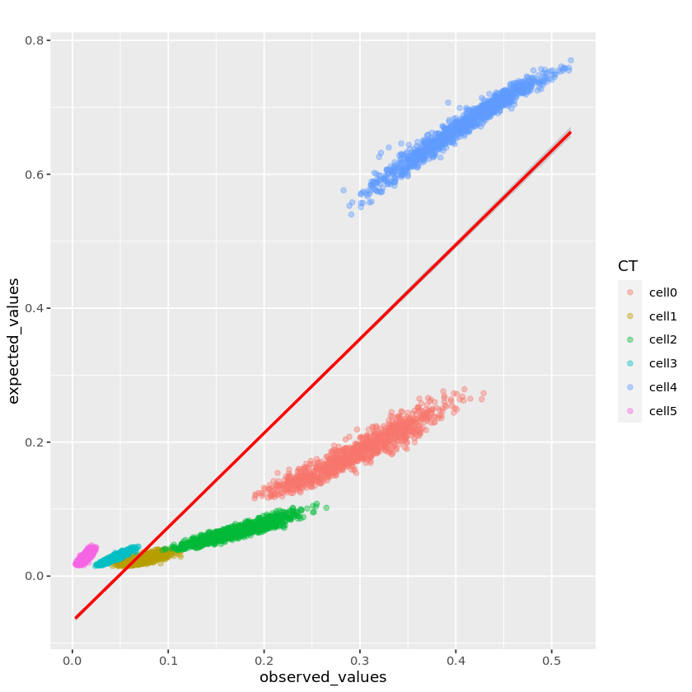
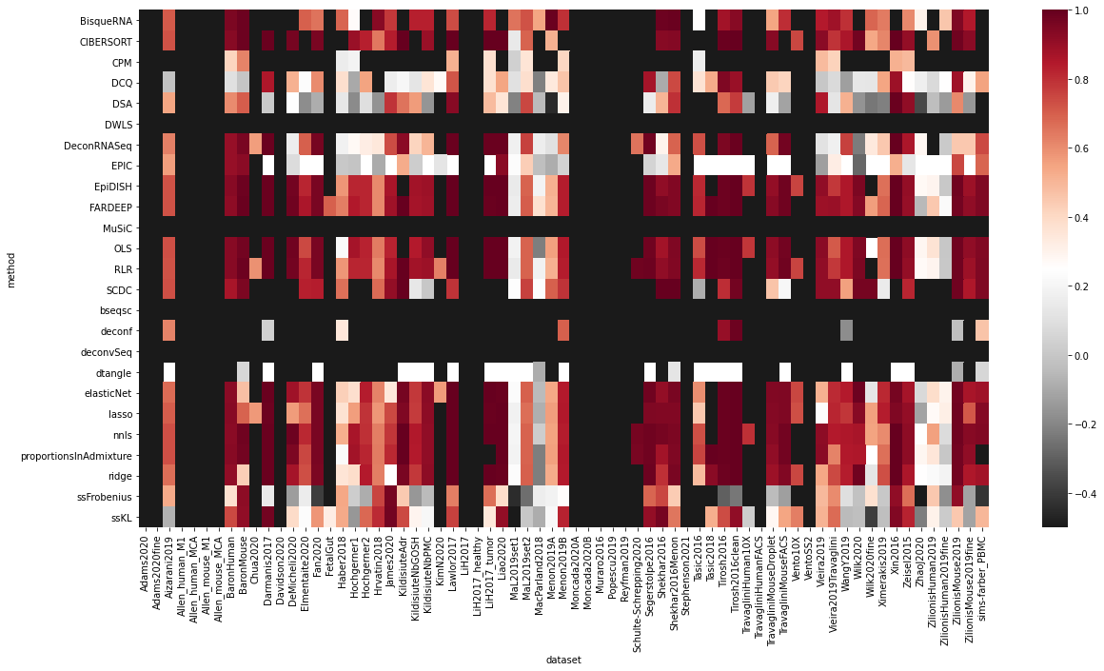
Normalization
Pseudobulk
#CT the same as in reference/random 2-N
#cell proportional to known data, with fluctuation/random sampling
Generate 1K pseudobulk
Each pseudobulk includes TT cells
Transformation
Deconvolution

Slide 27
A large-scale benchmarking of cell type deconvolution methods
Chichau Miao, Anna Vathrakokili Pournara, Irene Papatheodorou

Slide 28
Experimental design
aim | Bulk | Reference
1: decide the parameters | pseudobulk made from reference | scRNA-seq
2: realistic benchmarking | pseudobulk made from another reference (batch effect) | scRNA-seq
3: benchmarking & potential application | Bulk RNA-seq of the same tissue | scRNA-seq
4: benchmarking & potential application | Bulk RNA-seq of the same tissue | 2 scRNA-seq

Slide 29
CATD
Framework
`Framework.R`
dependencies
Data preprocessing
`benchmark.R`
CATD_script.R
Calculate Results
`result.R`
I/O
self-reference
cross-reference
Bulk-reference
Bulk-2references
Marker genes
Convert from python to R
`format.R`
Normalization
Transformation
Python scripts
To run jobs
Deconvolution
`deconvolution.R`

Slide 30
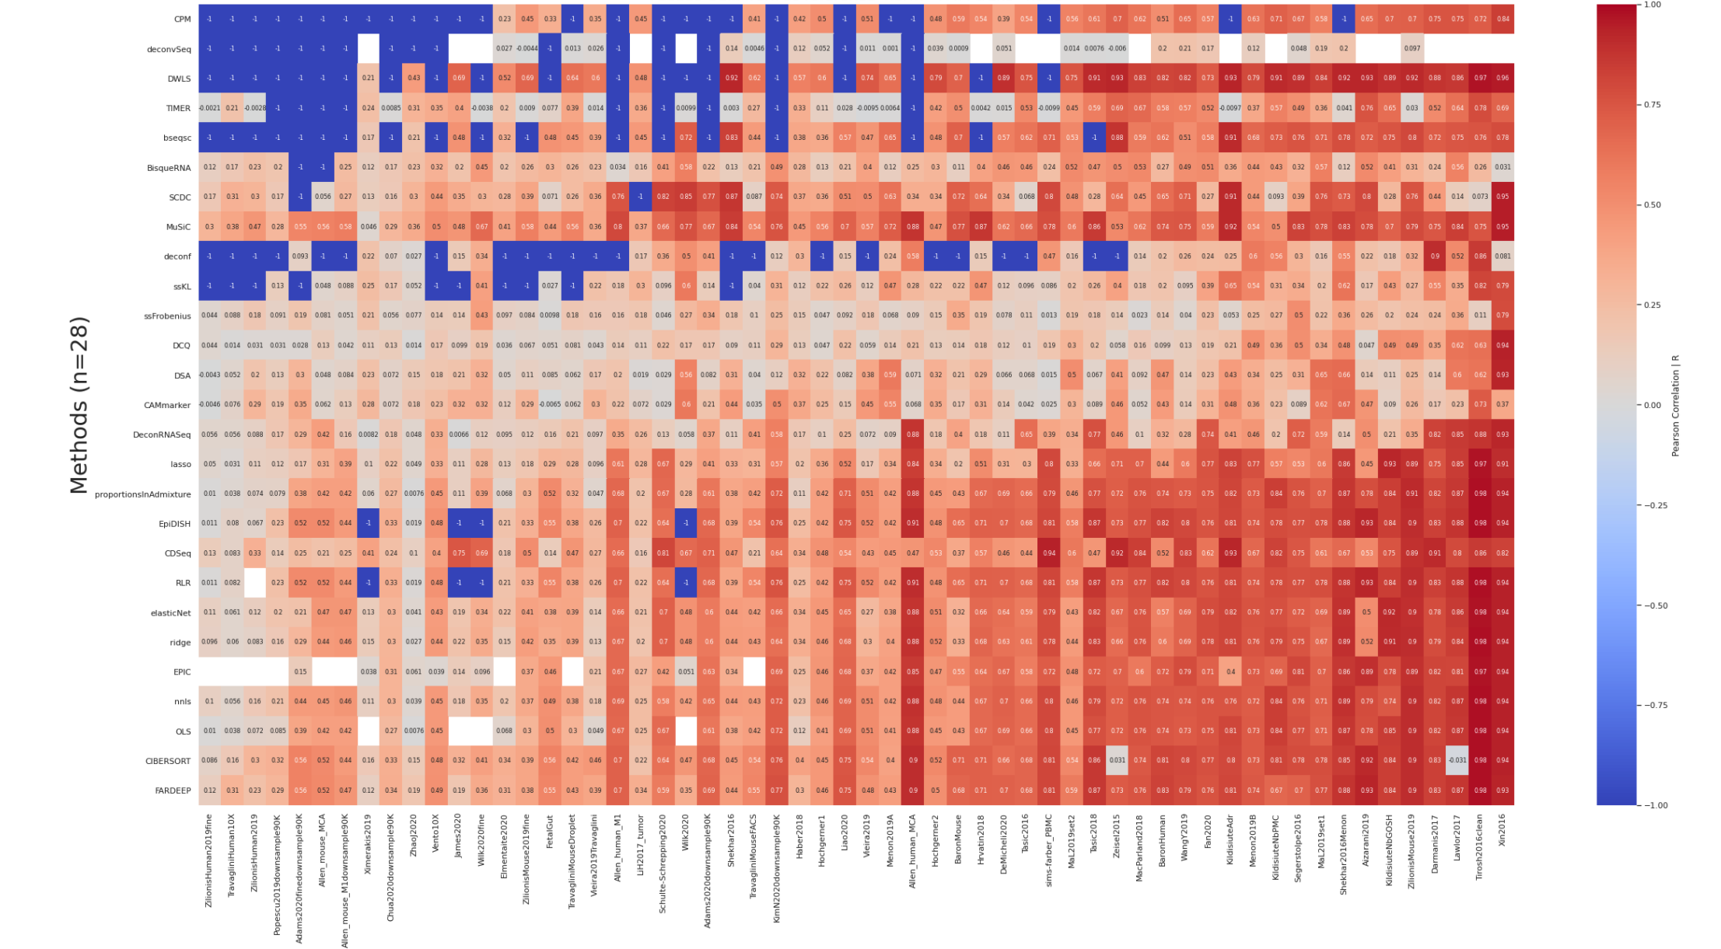

Slide 31
Experiments in self-reference
Normalize first or Transform first?
Random sample cell types or proportional sampling?
Sample cell types or not?
How many cells to sample?
Normalization methods comparison (use log or none transformation).
Transformation methods comparison (use to top normalization methods)

Slide 32
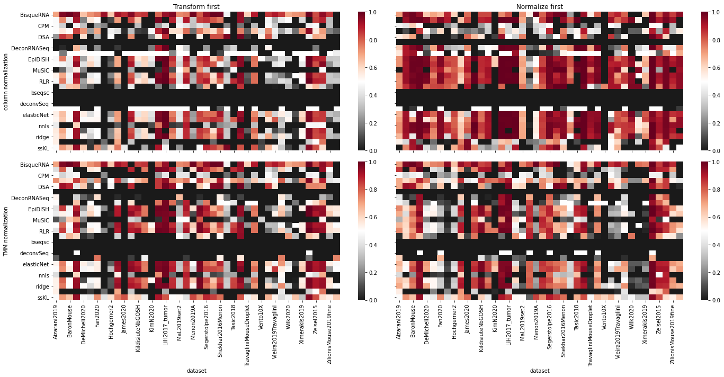
Exp1: Normalize first or Transform first?

Slide 33
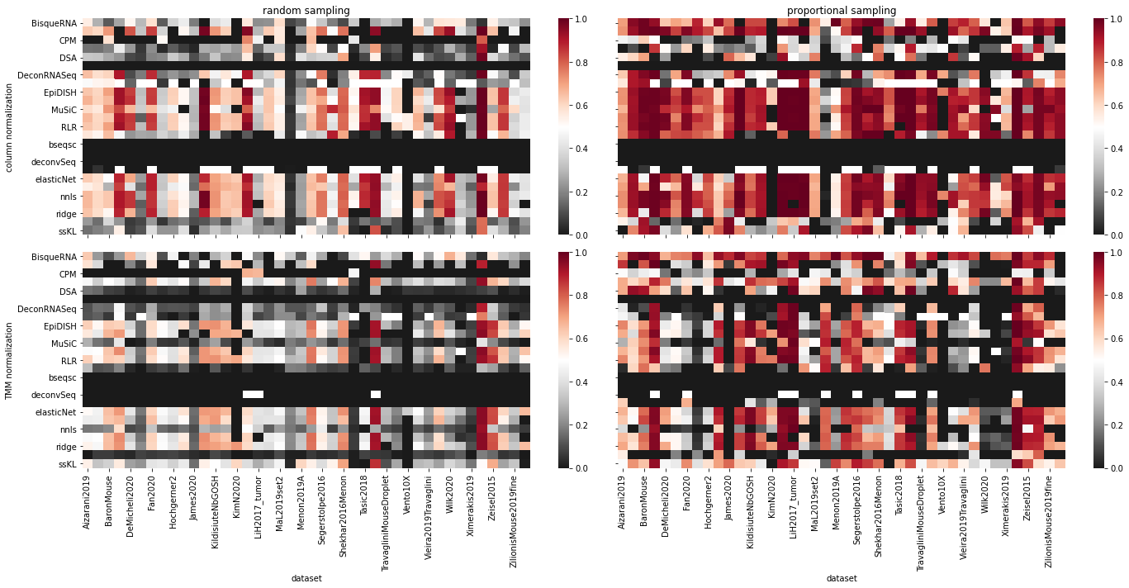
Exp2: Random sample cell types or proportional sampling?
Column/TMM + log1p

Slide 34
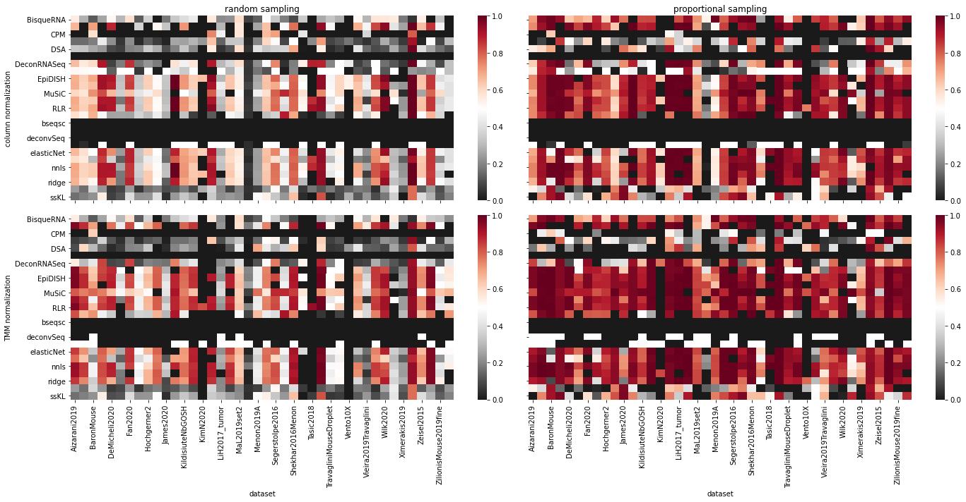
Column/TMM + none

Slide 35
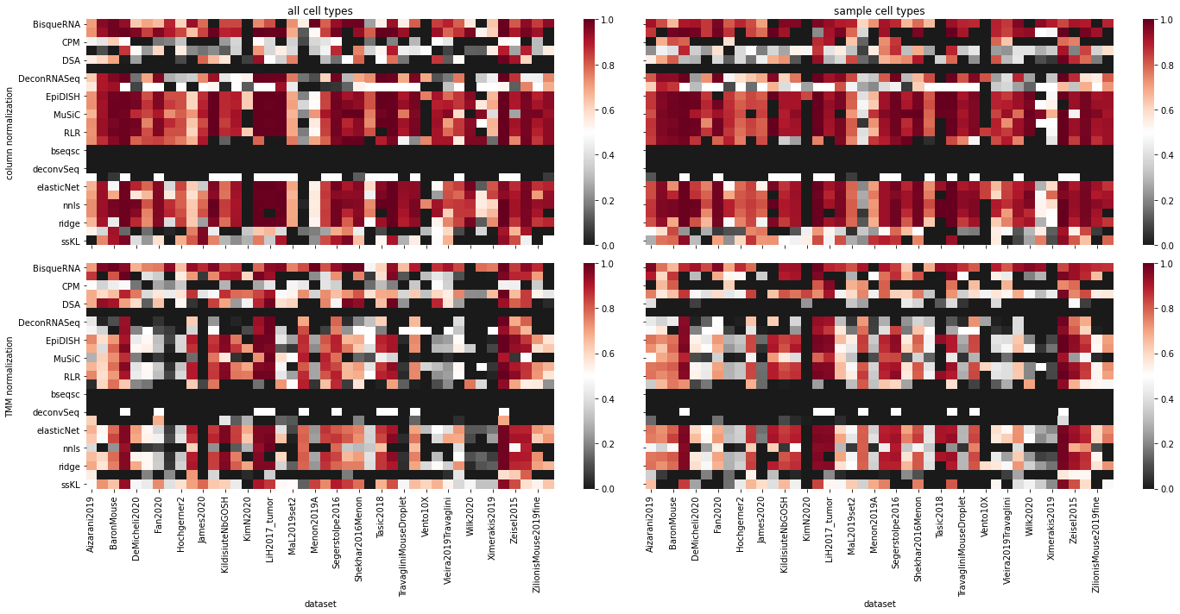
Exp3: Sample cell types or not?
Column/TMM + log1p

Slide 36
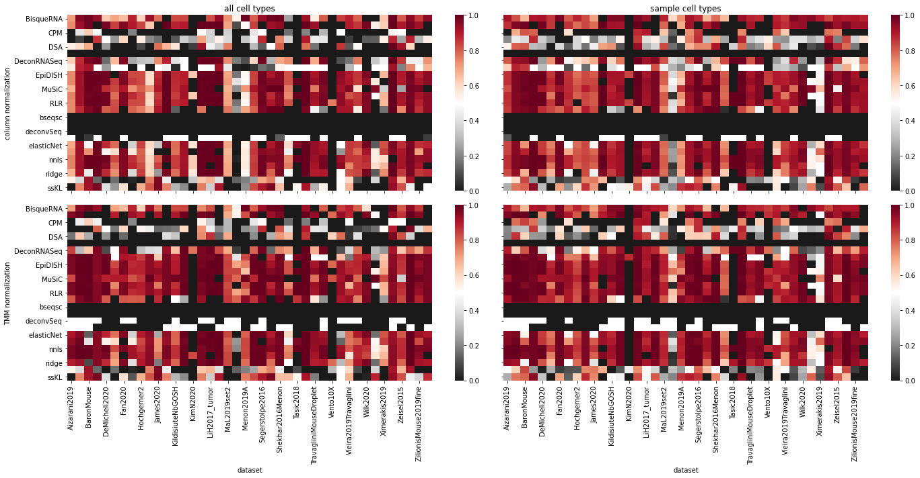
Column/TMM + none

Slide 37
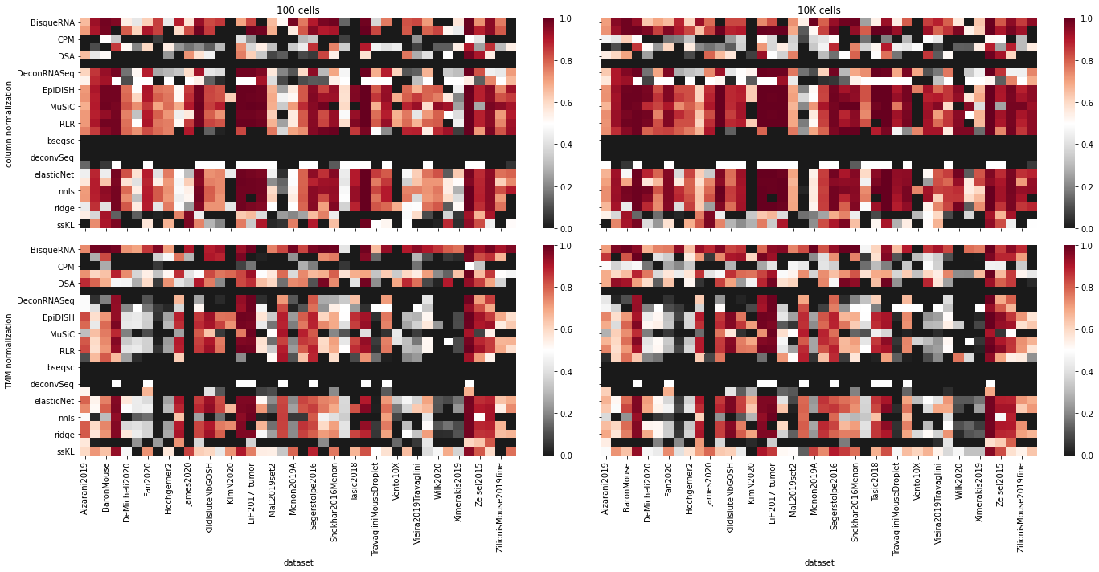
Exp4: 100 cells vs. 10K cells.
Column/TMM + log1p

Slide 38
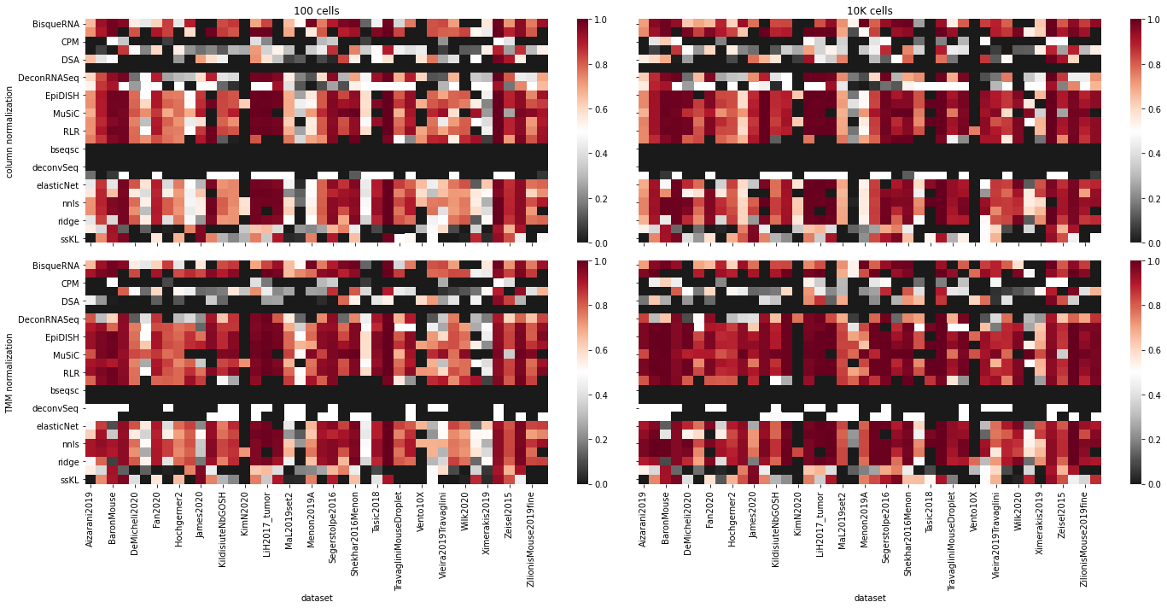
Column/TMM + none

Slide 39
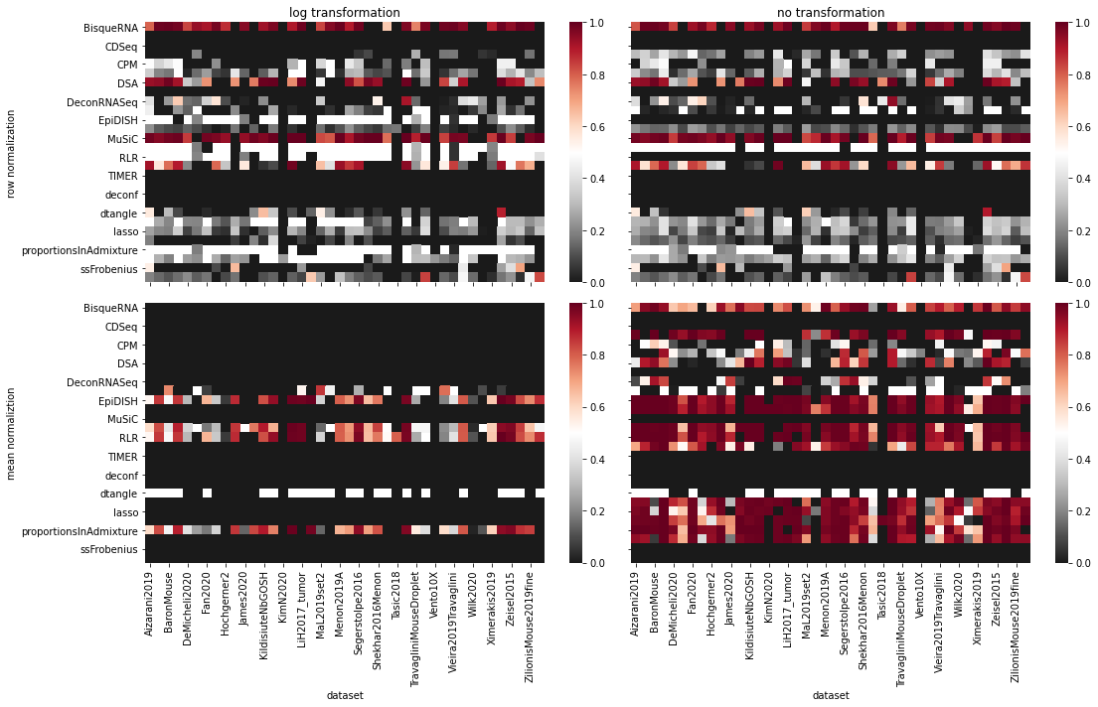
Exp5: Normalization methods

Slide 40
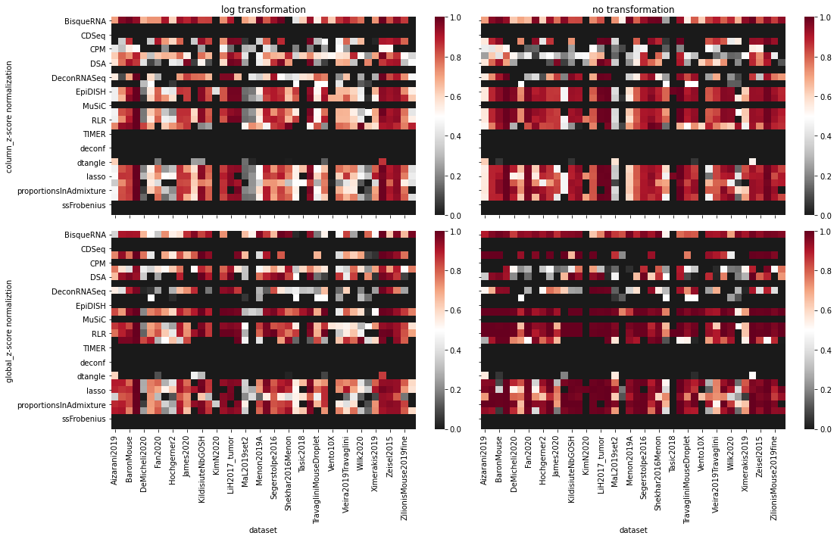

Slide 41
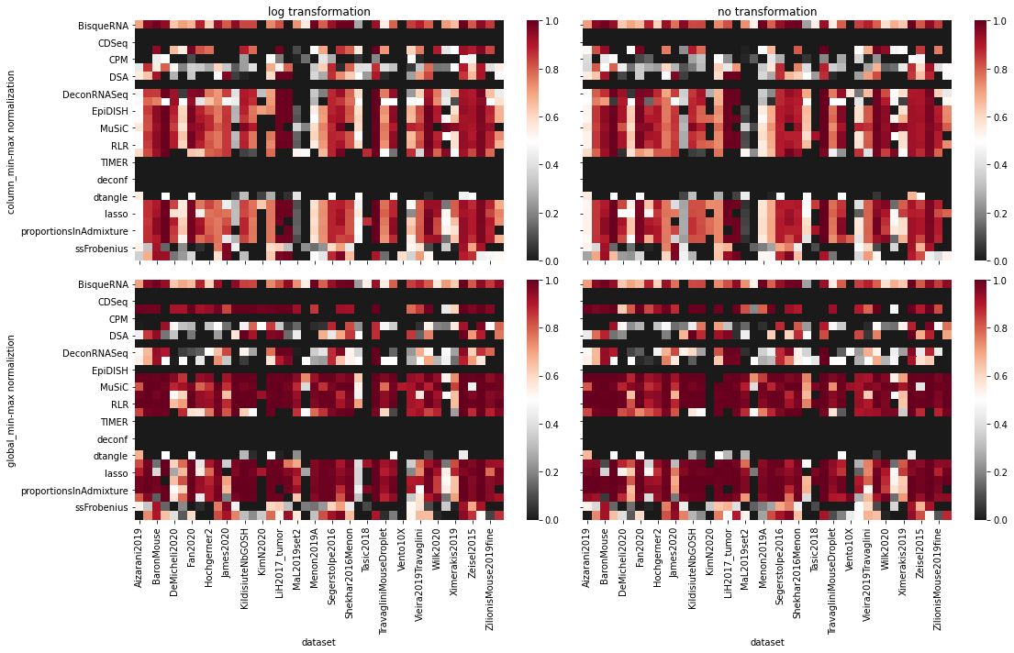

Slide 42
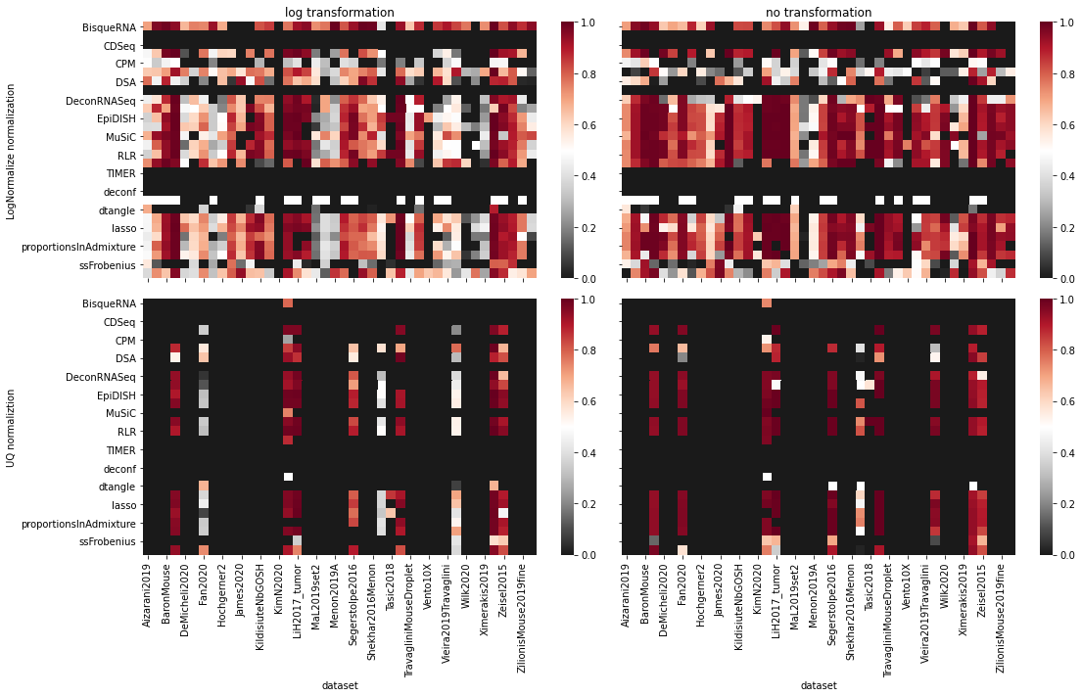

Slide 43
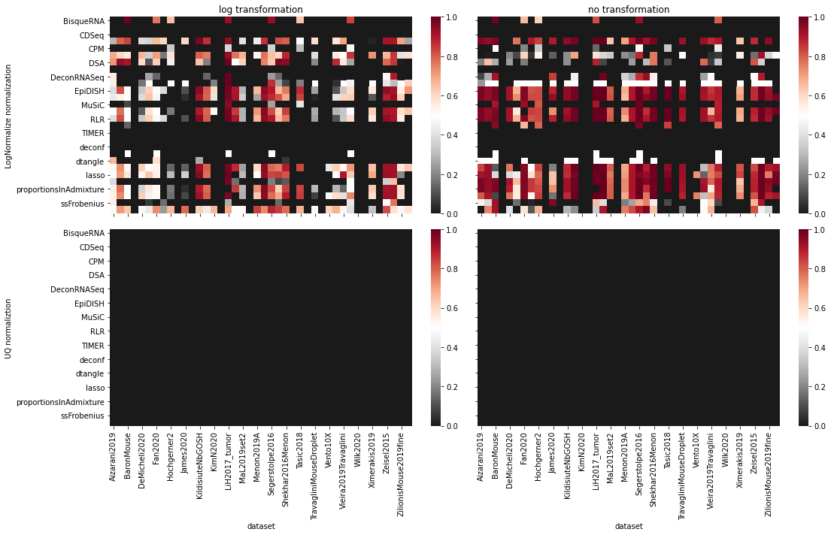

Slide 44
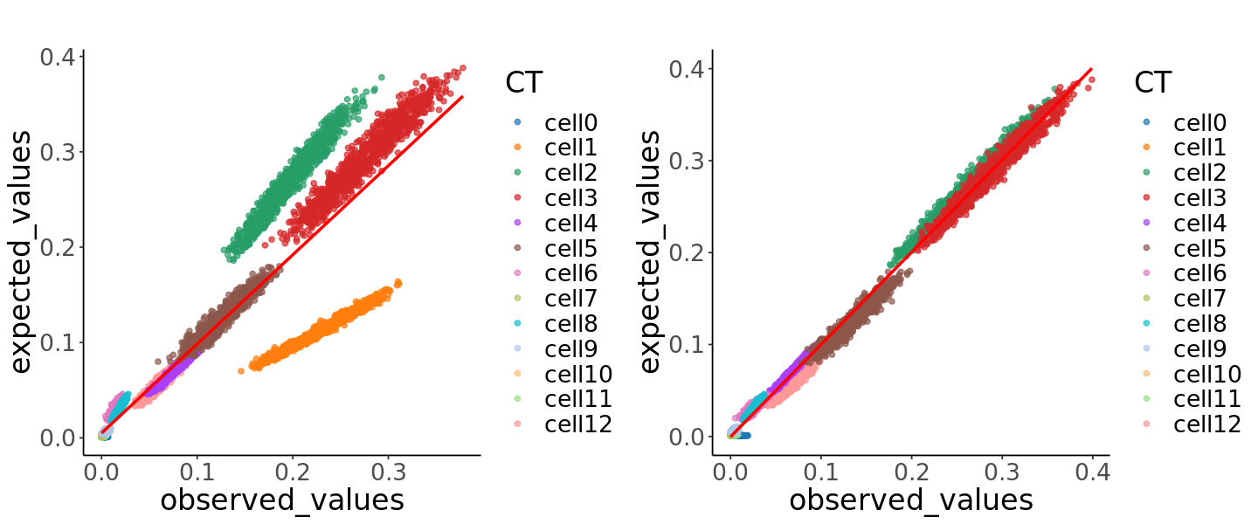
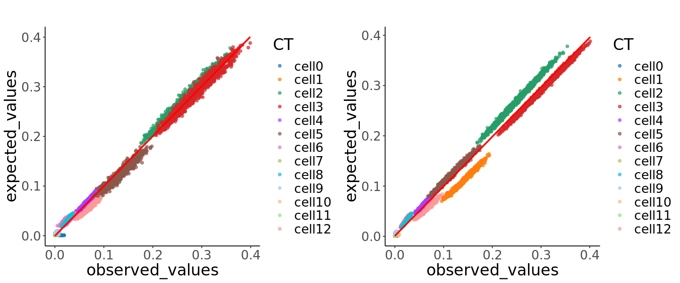
log
linear
Fardeep
Music

